Slide 1

A Brief Introduction to HDR
CS 418: Interactive Computer Graphics
UNIVERSITY OF ILLINOIS AT URBANA-CHAMPAIGN
Eric Shaffer

Slide 2
Dynamic Range
Most Many current image technologies fail to record or display
All the colors visible to human perception
All of the luminance levels visible to human perception
We can’t see the entire range from moonless sky to sun in one scene…but much more than the LCD range

Slide 3

It Must be True…It’s on YouTube

Slide 4
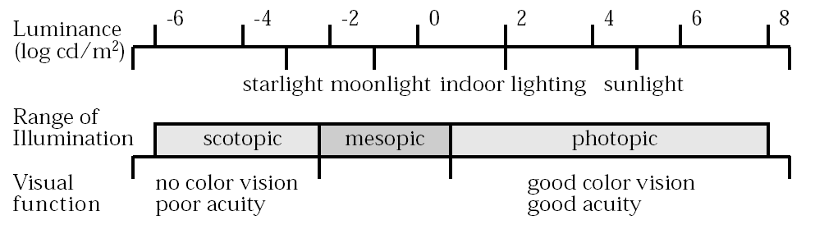
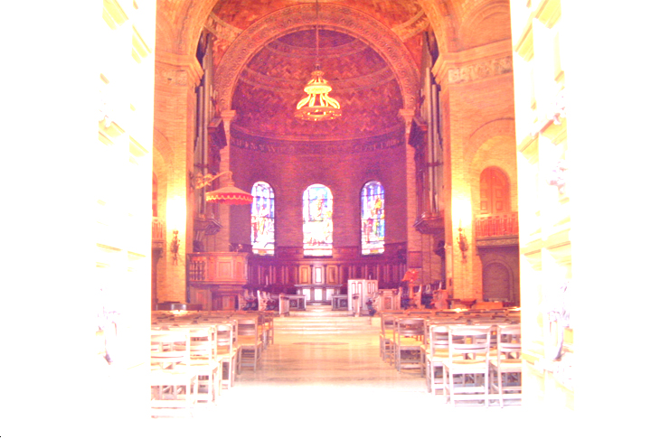
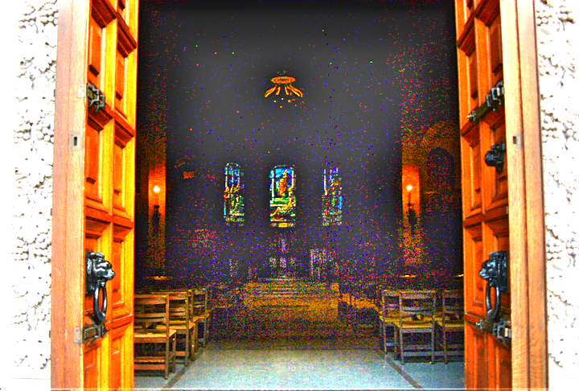
The Problem of Dynamic Range
Dynamic Range: Range of brightness values measurable with a camera
(Hood 1986)
Today’s Yesterday’s Cameras: Limited Dynamic Range
High Exposure Image
Low Exposure Image
We need about 5-10 million values to store all levels of brightness around us.
But, typical 8-bit cameras provide only 256 values

Slide 5
Scene-referred Image Capture

Slide 6
We should capture more than we can display…trivia
Sergei Mikhailovich Prokudin-Gorskii. In the early 1900s, Prokudin-Gorskii mapped out a plan for a photographic survey of the Russian Empire, a plan that won the support of Tsar Nicholas II. Between 1909 and 1915, Prokudin-Gorskii crisscrossed the Russian Empire via train, taking photographs of 11 different regions. 150 of his photographs are now on display to the public in Paris' Zadkine Museum, to commemorate what would have been Prokudin-Gorskii's 150th birthday.
Educated as a chemist, Prokudin-Gorskii studied with leading color photography experts in St. Petersburg, Berlin and Paris. Through his inventive tinkering, he created a new method for producing vibrant color film slides. Prokudin-Gorskii created color images by exposing one oblong glass plate three times, in rapid succession, through three different color filters: red, green and blue.

Slide 7
Examples (from Library of Congress)

Slide 8
Dynamic Range
Ratio between largest and smallest quantity under consideration
For imaging, the observed quantity is luminance
Several measures for dynamic range of luminance

Slide 9
Image Acquisition: Rendering
You can render HDR images….
Use floating point values for luminance
Retain “out of gamut” colors…tone map only on output
Which is rendered?

Slide 10
Image Acquisition: Photography
Older low-quality cameras typically produced JPEG images
e.g. webcams produced jpeg stills for video
…stayed under USB-2 bandwidth threshold
Camera performs tone-mapping
Tone mapping is a technique used in image processing and computer graphics to map one set of colors to another to approximate the appearance of high-dynamic-range images in a medium that has a more limited dynamic range.
Tone mapping - Wikipedia

Slide 11
Image Acquisition: Photography
Even on an SDR display, HDR capture can allow you to see things you otherwise wouldn’t
DLSR cameras offer RAW image files
Non-standard….hundreds of RAW formats
Usually 12ish bits per channel
Sort of intermediate range imaging
Simplest method of acquiring HDRI with LDR camera…
Is to take multiple pictures with different exposure settings
Generate single HDR image from weighted average
Most phones can now do this

Slide 12
Image Acquisition
Lots of interesting technical problems to be solved
How do we vary luminance when acquiring an image?
What problem(s) might you encounter with multiple images?
What factors might used to determine weights for the pixels?
…which we won’t discuss…

Slide 13
Image Storage
Large jump between JPEG and RAW
15 mega-pixel image is 3MB JPEG and around 176MB RAW
RAW = 3 x 32 bit floating point numbers per pixel
Several choices for compressed HDR pixels including
RGBE (Radiance)
OpenEXR (developed by ILM)
There are 1,056,964,609 single precision floating point numbers between 0 and 1
….meaning ½ of all the possible 32 bit words are used to represent numbers in [-1,1]

Slide 14
OpenEXR Image Storage
Pixel format uses 48 bits
Half-precision (16 bit) floats
Used on some GPUs
Floating point is suitable for large range variance
Can encompass multiple orders of magnitude easily
Limited to max of 65504
Values using absolute radiances need to be rescaled

Slide 15
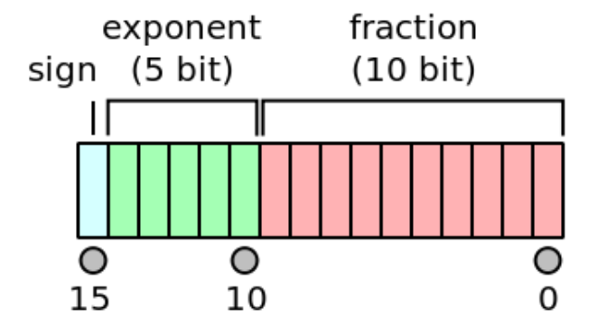
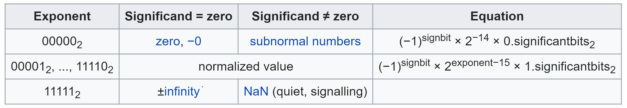
And…How Does Floating Point Work Again?
IEEE 754 Half-Precision Floating Point

Slide 16
Image Storage
RGBE (Common Exponent)
Used in Radiance file format
Radiance is a suite of tools for performing lighting simulation
32 bits total
8 bits for mantissa in each color channel
8 bits for a common exponent
Possible since color channels highly correlated
Values with same order of magnitude

Slide 17
Radiance File Format
Conversion from RGBE to RGB
Exposure → rescaling of the value
E_{w} → “efficacy of white constant equal to 179”
From RGB to RGBE

Slide 18
Tone Mapping
Goal is to render scenes of high contrast and large gamut on devices that are more limited
LOTS of tone-mapping operators with different goals
Visual System Simulators (VSS): mimic human perception
Scene Reproduction (SRP): Reproduce scene most faithfully
Best Subjective Quality (BSQ):Achieve artistic goals

Slide 19
Tone Mapping: Brightness Change
B increases or decreases brightness
Similar to changing exposure in conventional photography
Does it effect dynamic range?

Slide 20
Tone Mapping: Contrast Change
A power function
L_{white} is luminance of reference white point
Usually peak luminance of display
Image range is grown or shrunk away from L_{white}
C is the contrast parameter

